Slide 1

Blade of the Lost: The Silent Survivor
Developers: Josef Bacík (312553801) and Eduin Hernandez (艾德文 - 0860828)
Instructor: 黃世強
https://wallpapersafari.com/w/Ppzkj5

Slide 2
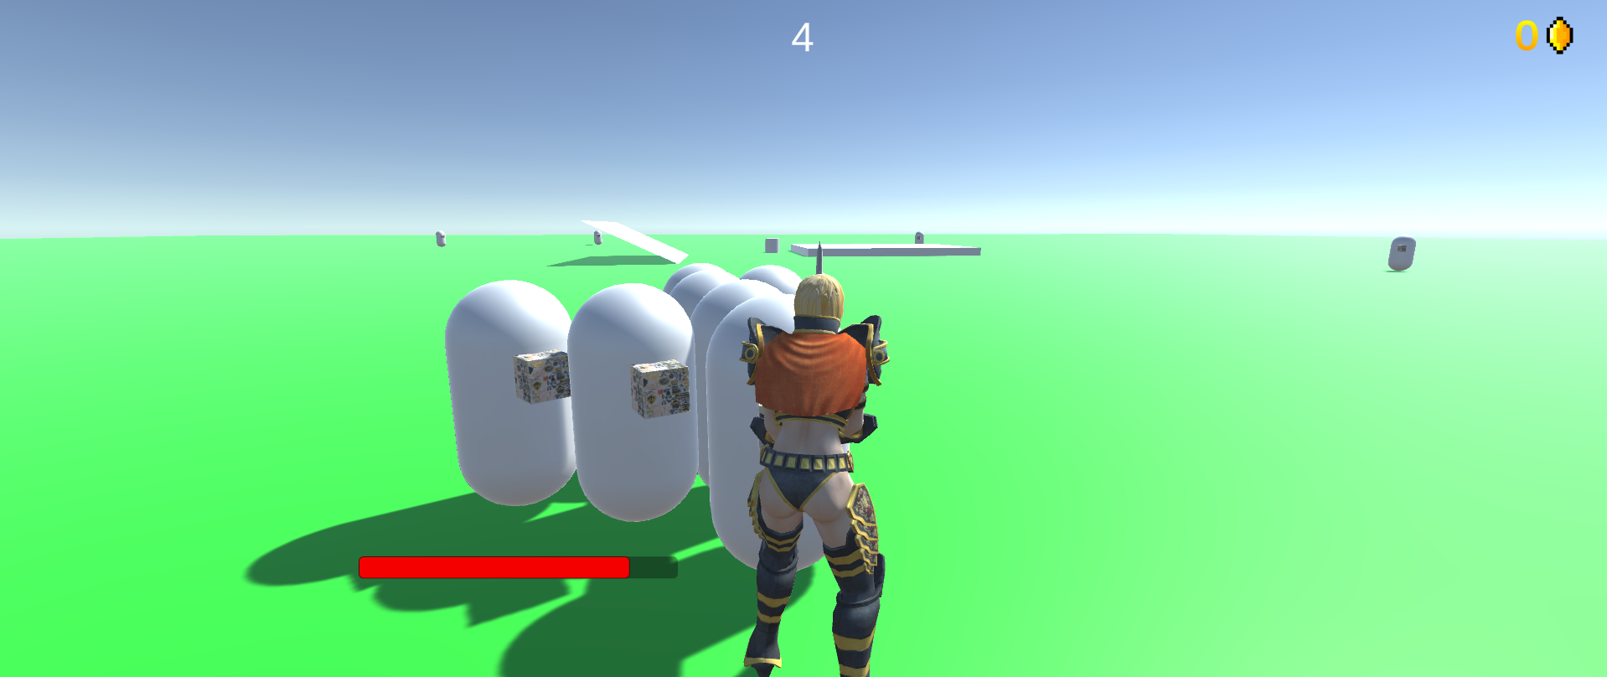
Game Story
Character: Bob (?)
Scene: World of mystery and danger
Description:
Bob awakens with no memories of himself or recollection of where he is at,
only muscle memories of how to use the sword beside him
He must use it fight relentless battles against a never-ending hoard of bizarre creatures to survive
[Current Gameplay]
Notes:
Our hero, Bob, awakens with no recollection of his past, thrown into a chaotic world teeming with bizarre creatures. Armed with a mysterious sword and an unwavering will to survive, Bob's relentless battles lead him to hidden relics and newfound abilities, drawing him ever closer to unveiling the secrets of this enigmatic realm and the malevolent adversary that holds the key to his escape. Dare you enter a world where the truth lies hidden beneath the edge of a sword and redemption winds through the unknown?

Slide 3

System Requirements
CPU: Intel Core i3 / AMD equivalent
RAM: 4 GB RAM
GPU: Integrated
DX: Version 11
OS: Windows 10, 64-bit / Windows 11, 64-bit
STORAGE: 1 GB available space

Slide 4
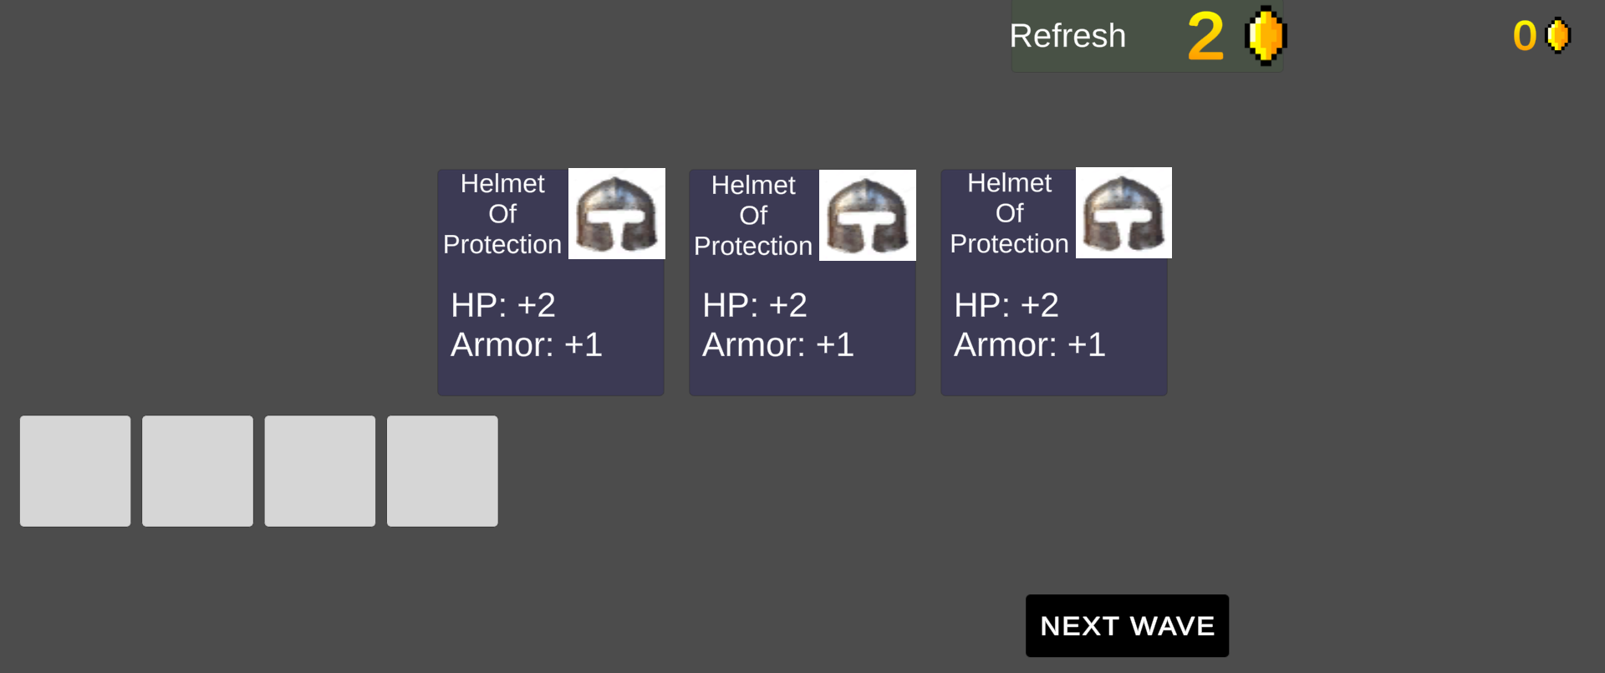
Gameplay
Combat and Power-Ups
Two different attacks
Collect coins from defeated foes
Purchase power-ups from the shop
Vital for survival
[Current Development of the Game]

Slide 5
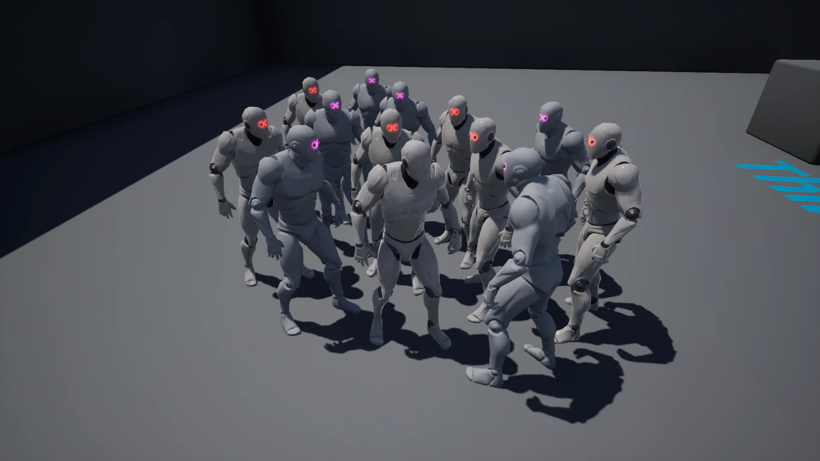
Gameplay
Timed Waves
Time-based enemy waves
Skillful dodging and tactical positioning
Adrenaline and urgency
[Internet: https://www.unrealengine.com/marketplace/en-US/product/enemy-wave-spawner-multiplayer-supported]

Slide 6
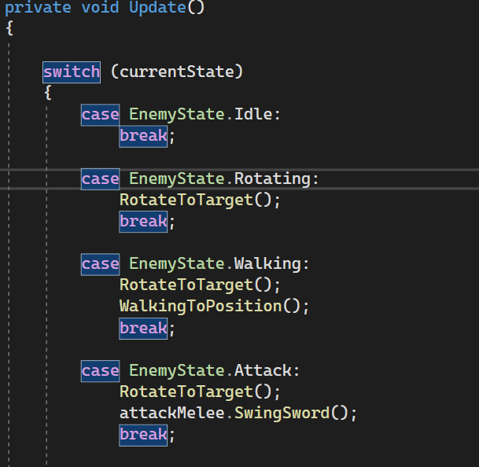
Gameplay
Diverse Enemies
2-3 enemy types
Unique behaviors and combat patterns
Increasing difficulty
[Current Development of the Game]

Slide 7
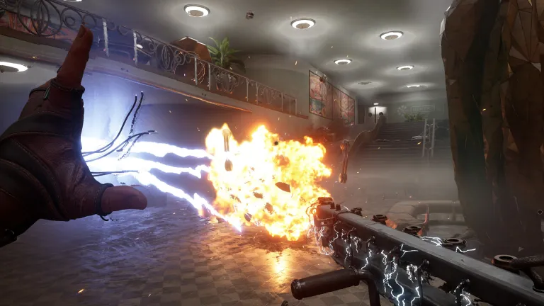
Gameplay
Special Skills
Special skills for players
Variety of abilities
Turn the tide of battle
[Internet: https://www.denofgeek.com/games/atomic-heart-best-character-builds-skill-upgrades/]

Slide 8
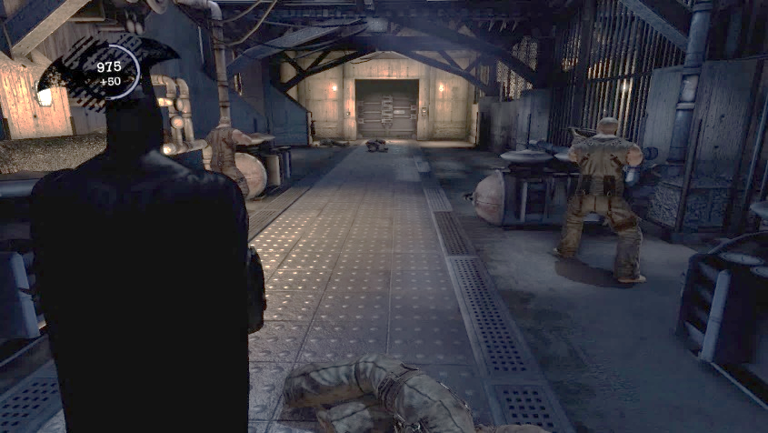
Gameplay
3rd Person Camera
3rd person perspective
Limited view backward
Enhanced situational awareness
[Internet: https://www.gamedeveloper.com/design/third-person-camera-view-in-games---a-record-of-the-most-common-problems-in-modern-games-solutions-taken-from-new-and-retro-games]

Slide 9
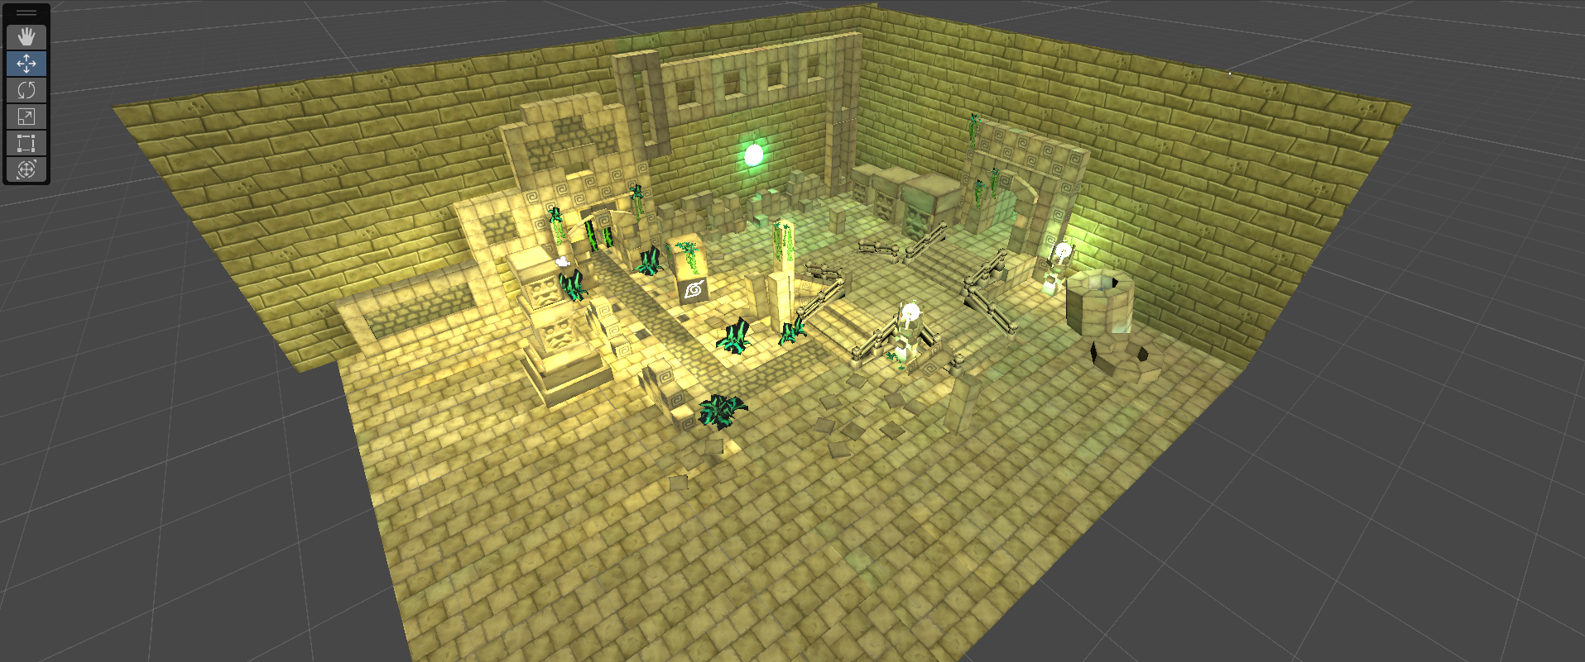
Gameplay
Dynamic Arena Designs
Aid in kiting enemies
Limited vertical movement
Strategic positioning and maneuvering
[Current Development of the Game]

Slide 10
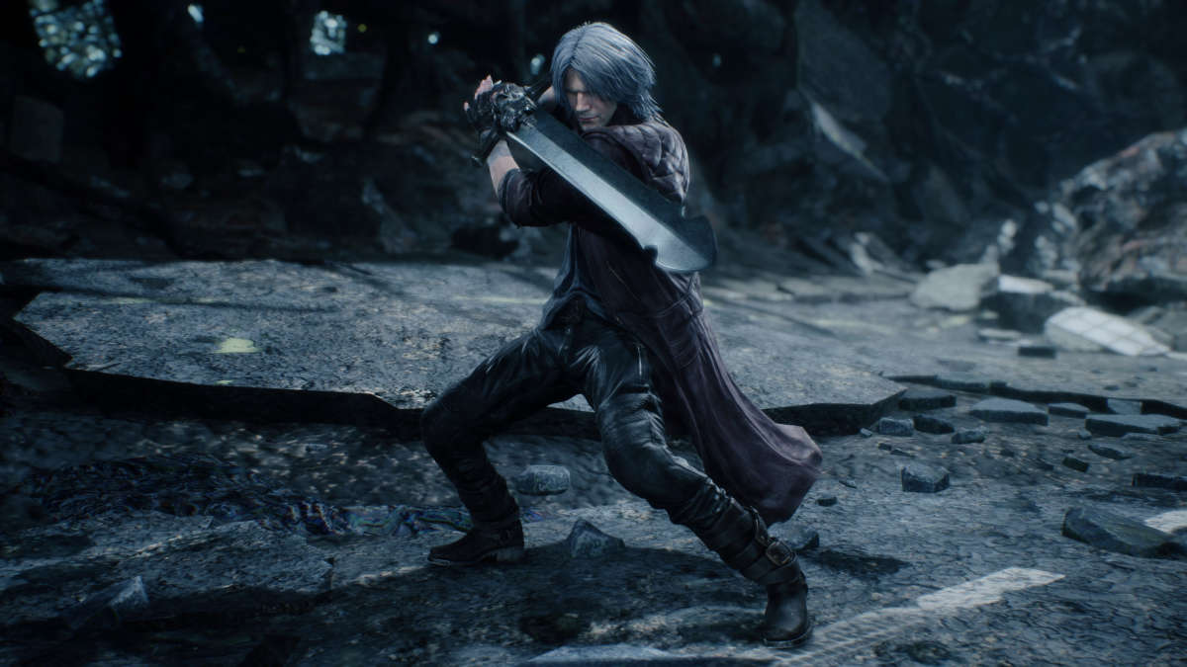
Milestones
Basic Gameplay and Systems
Develop core mechanics
Player controls, basic enemy, shop
Rudimentary combat and inventory system
[Internet: https://rpp.pe/tecnologia/videojuegos/devil-may-cry-5-estos-son-sus-requisitos-minimos-noticia-1151215]

Slide 11
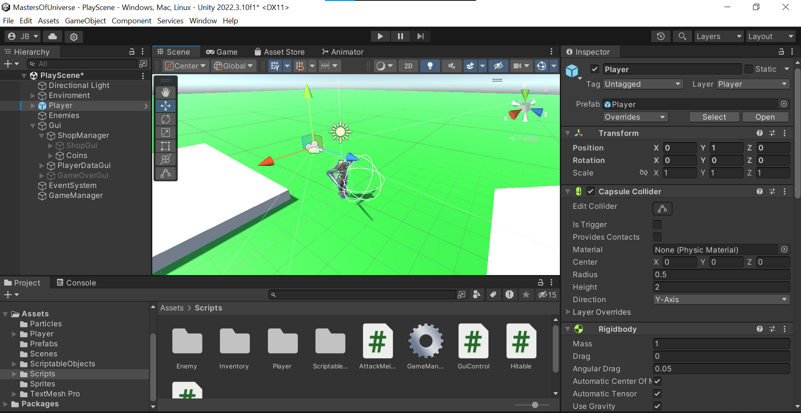
Milestones
World Building and Aesthetic Enhancements
Create the game's arena
Advanced statistical tracking
Downloaded 3D models and assets
Character Animation and Combat Refinement
Animate player and enemy
Enhance combat abilities
Connect shop, inventory, and statistics
[Current Development of the Game]

Slide 12
THANK YOU!

